Slide 1

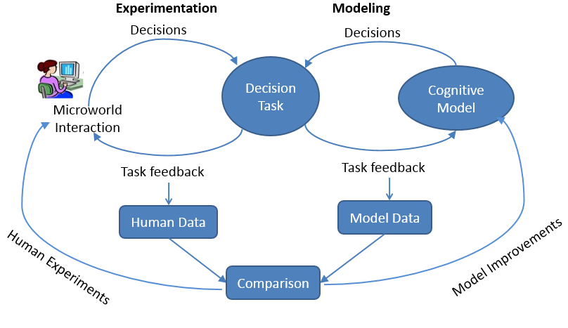
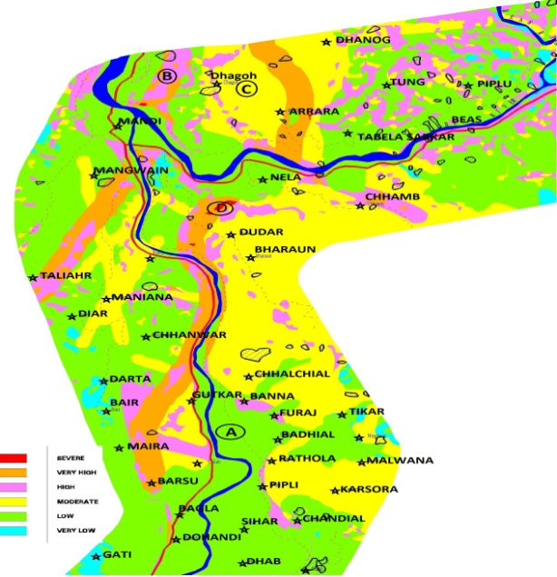
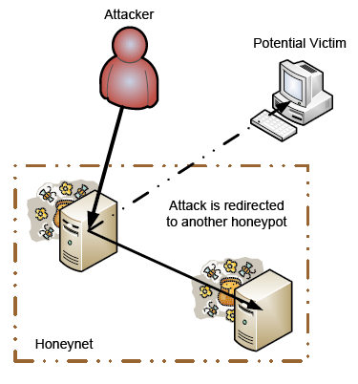
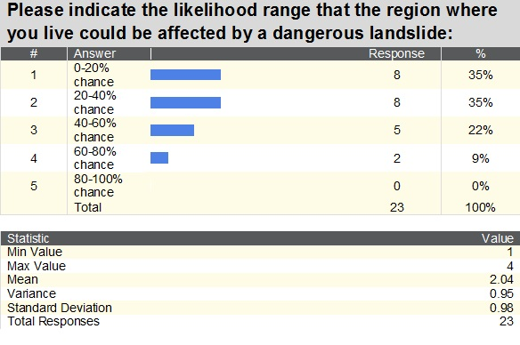
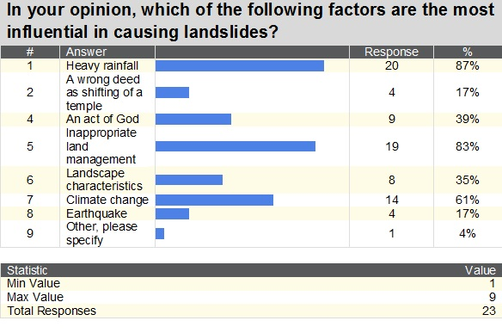
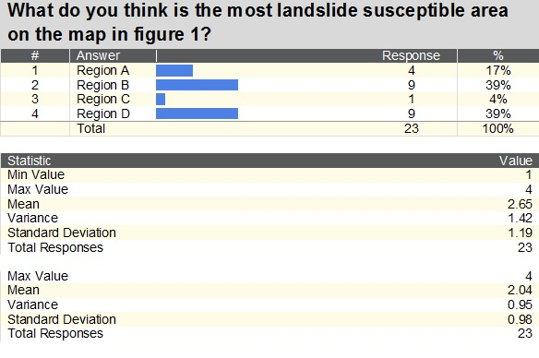
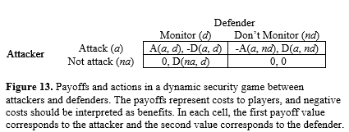
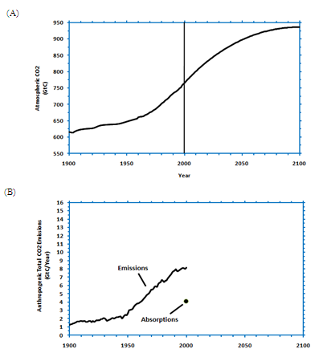
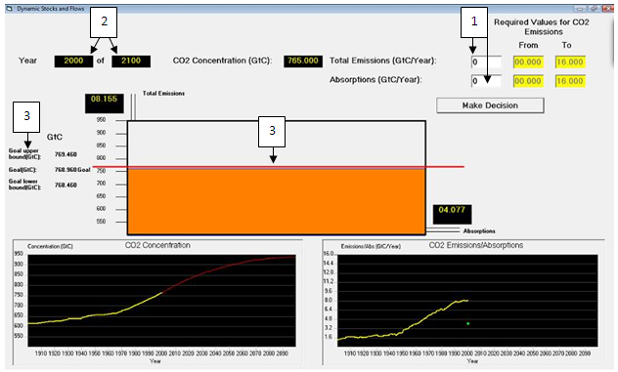
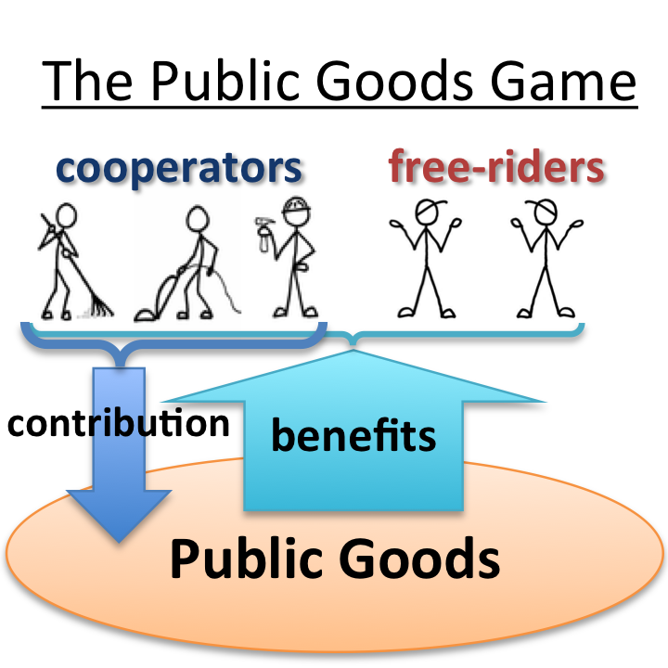
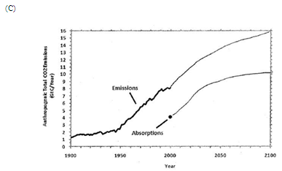
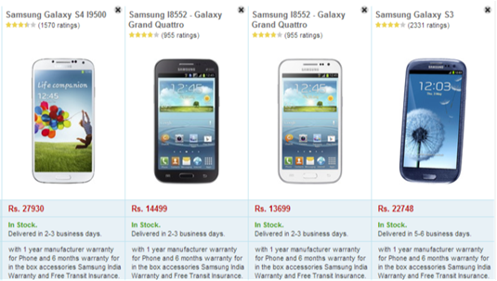
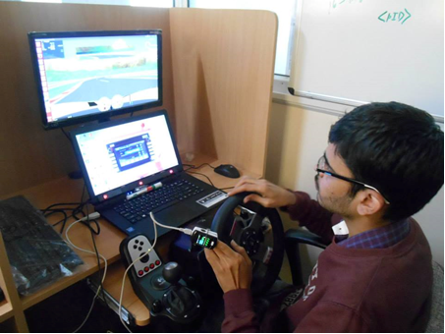
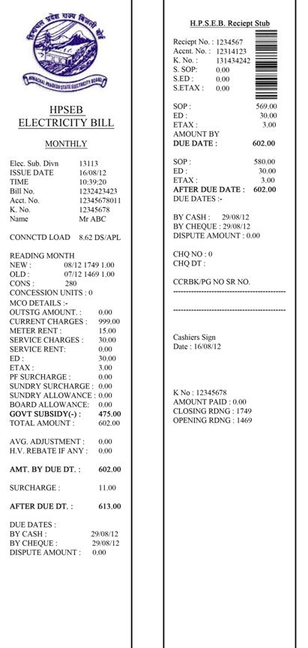
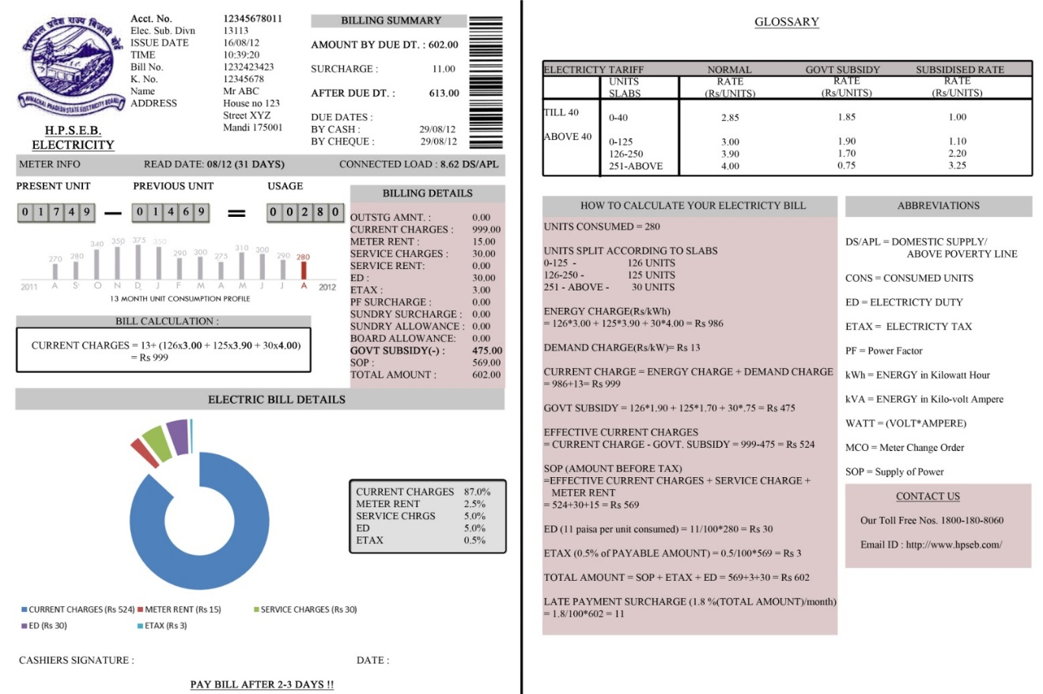
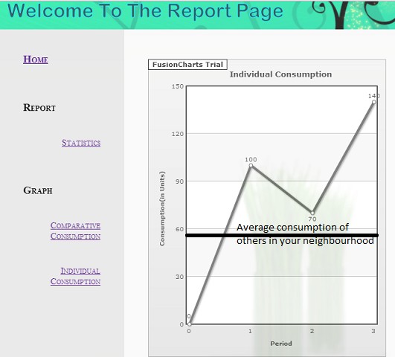
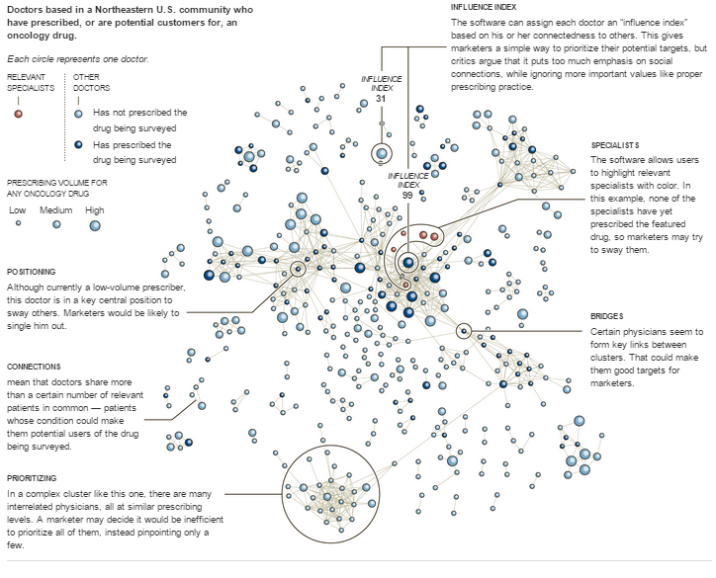
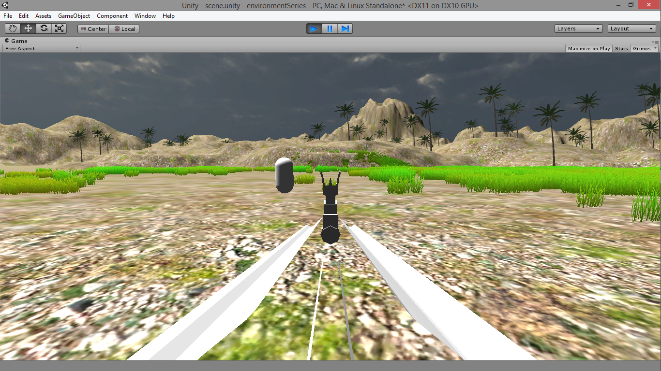
Applied Cognitive Science (ACS) Lab
Dr. Varun Dutt, Assistant Professor & Principal Investigator
IIT Mandi, H.P., India – 175001 Phone: +91-1905-267041 Email: varun@iitmandi.ac.in
Introduction to ACS Lab
Public perception of landslides in Himachal Pradesh
Objective: The main objectives of the study are the following: (1) To evaluate the public knowledge, risk perception, and attitude towards landslides. (2) To evaluate the influence of emotional appeal via imagery or information on knowledge, risk perception and attitude towards landslides. Methodology: The approach involves evaluating the knowledge, risk perception and attitude of people towards landslide risk using surveys in different districts of Himachal Pradesh. We plan to systematically manipulate emotions via information or imagery before presenting surveys to understand their effects. Implications: The study has implications for improving risk perception and awareness among people and in providing better decision support to policy makers in countering landslide risk.
Researchers: Dr. Varun Dutt, PI; Pratik Chaturvedi (graduate student), DTRL, DRDO. Support: DTRL, DRDO
Role of monetary losses and information sharing on negotiations against climate change
Objective: The main objective is to study the role of climate-change losses and information sharing among players on monitory contributions made against climate change. Methodology: The project involves the use of a modified public-goods game in which players make investments towards a public climate fund to mitigate climate change. The money put in public fund is multiplied by a factor and the return generated is equally divided amongst all players. The project will manipulate climate-change losses and information sharing among players and use laboratory experiments and computational modelling to derive conclusions. Implications: Understanding how climate-change losses and informational sharing influences people’s contributions will help in effective policymaking against climate change.
Driving Decisions
Effect of road conditions on gaze-control interface in an automotive environment
Researchers: Dr. Varun Dutt, PI; in collaboration with Dr. Pradipta Biswas (Cambridge University, UK). Vinod Kumar and Antim Patel (undergraduate students). Support: IIT Mandi, Cambridge University
Data Mining and Data Analytics
Machine Learning and Data Mining for Sales and Analytics in Pharma
Objective: Study how social network analysis and social media information could be used for finding prescribing histories and relationships among doctors, and for pinpointing highly connected or critical physicians, who are the best potential targets for marketing medicines using personal and non-personal methods. Methodology: The main methodology employed will be Social Network Analysis (SNA) (Figure 11), where SNA views social relationships in terms of network theory, consisting of nodes (representing individual actors within the network) and ties (which represent relationships between the individuals, such as Facebook friendships, email correspondence, hyperlinks, or Twitter responses). We will use a number of open-source software to data-mine social media in order to construct SNs. Implications: The main implications are in finding critical networked agents in a society for marketing products.
Cyber Security
Role of deception in cyber attack detection
Building a secure and trustworthy cyberspace: A behavioral game-theoretic approach
Decisions from Experience
Decisions under Risk: Modeling Choices at the Individual Level in Decisions from Information Search
Decisions under Ambiguity: Role of Set Size, Payoff Variability and Experienced Expected Value (EEV) on the D-E gap
Decision Making for Defense Applications
Understanding soldier’s cognition against adversaries in V-R Defense games
Objective: The main focus of the lab is to investigate decision making and cognition in applied domains. Some key domains include our environment, consumer behavior, cyber security, vehicle driving, natural disasters, and gambling.
Methodology: Our research methodology includes conducting laboratory experiments where we collect human behavioral data using simulation games (also called “microworlds”) and we use computational cognitive models based on the cognitive ACT-R architecture and other approaches to understand and predict such behavior.
Resources: The laboratory consists of post-doctoral fellows, graduate and undergraduate students, and student interns. The lab members come from different fields which include computer engineering, electrical engineering, and humanities and social sciences. The lab infrastructure includes an air-conditioned (hot and cold) environment with state-of-the-art 7 AIO Desktops, 1 workstation, driving simulator, Oximeter, Emotiv® 14-channel EEG headsets, Tobii® Eye Tracker, and other accessories. There is a plan to get a 32-channel EEG/ERP headset in the near future.
Applications: Our results and conclusions extend to applied domains. For example, our conclusions help to understand the effects of existing designs on human cognition and how improvements in existing designs could enhance cognition. Our research also helps in developing training interventions in applied domains. For example, training security analysts against certain kinds of cyber-attacks helps to improve their on-job performance.
Objective: To account for cognitive limitations on memory and recall for attackers and defenders and explore experiential decisions made by attackers and defenders in cyber-security games that involve deception (Figure 12). Methodology: Actions of attackers and defenders will be associated with payoffs and the goal of each player is to maximize her payoff. The project will focus on the development of computational cognitive models of attackers and defenders and validating model predictions via experiments. Implications: Help improve current technical solutions and provide better decision support to defenders in countering cyber attacks via deception.
Figure 12. Using Deception to lure an attacker into a honeypot and evade a potential victim
Researchers: Dr. Varun Dutt, PI; Palvi Aggarwal (graduate student). Support: DIETY (Visvesvaraya PhD scheme)
Figure 5. The 2007 landslide in Khaliyar (Mandi)
Figure 6:Landslide Susceptibility Map of Mandi district, H.P.
Objective: Study the influence of motivational factors (e.g., costs and benefits of actions from the attacker’s and defender’s viewpoint), environmental factors (e.g., information available to players about each other), and technology constraints (e.g., how network responds based upon the defender’s actions and network’s accuracy about reporting attacks) on the interaction between attackers and defenders. Methodology: The methodology requires using simple 2x2 games between attackers and defenders, where each role has two actions. The work will require computational modelling and experimentation to validate model predictions. Implications: This basic research program will help meet our nation’s cyber-security goals by evaluating the role of motivational, environmental, and technological factors on cyber attack detection.
Figure 7. Some results from a survey conducted at Mandi
Researchers: Dr. Varun Dutt, PI; Dr. V. S. Chandrasekhar Pammi, Co-PI (CBCS, Univ. of Allahabad); Dr. Debarati Bandyopadhyay (Post-doc); Zahid Maqbool (graduate student). Support: DST
Research @ ACS Lab
Environmental Decision Making
Improving public understanding of climate change
Researchers: Dr. Varun Dutt, PI; in collaboration with Prof. Cleotilde Gonzalez (Carnegie Mellon University, USA). Support: IIT Mandi
Improving public understanding of electric energy consumption patterns via social norms and feedback
Researchers: Dr. Varun Dutt, PI; Support: Submitted for support
Researchers: Dr. Varun Dutt, PI; in collaboration with Prof. Cleotilde Gonzalez (Carnegie Mellon University, USA). Medha Kumar (graduate student). Support: IIT Mandi
Objective: To test the ability of computational models of aggregate choice to explain choices at the individual level in tasks involving choices after sampling information. Methodology: Top three DFE models of aggregate choices are evaluated on how these models account for individual choices. A Primed-Sampler (PS) model, a Natural-Mean Heuristic (NMH) model, and an Instance-Based Learning (IBL) model are calibrated to explain individual choices in the Technion Prediction Tournament (the largest publically available DFE dataset). Results: Results reveal that all the three DFE models of aggregate choices perform well to explain individual choices. Although the PS and NMH models perform slightly better than the IBL model; the IBL model is able to account for all individuals in the dataset compared to the PS and NMH models. Implications: Developing models that predict choices in a large class of decisions involving sampling before a choice (e.g., choosing careers, online or offline consumer choices, etc.).
Figure 8. The Public Goods Game (Allen, 2011)
Figure 14. Buying a phone after sampling prices and customer rating.
Figure 1. The climate Stabilization (CS) Task. (A) Participants are given CO­₂ concentration stabilization scenario, and (B) they are required to sketch the CO₂ emissions and absorptions corresponding to the scenario. (C) A typical response showing reliance on the correlation heuristic (emissions similar in shape to CO₂ concentration) and mass balance violation (emissions > absorptions in 2100, i.e., when CO₂ concentration stabilizes).
Figure 2. The Dynamic Climate Change Simulator (DCCS) microworld. The microworld is a dynamic replica of the CS task. (1) Participants set yearly CO₂ emissions and absorptions and press Make Decision button. (2) The system now moves forward a certain number of years. (3) Participants need to maintain their CO₂ concentration at the red goal line in the tank (which represents the atmosphere) and follow the CO₂ concentration trajectory shown in the bottom left panel.
Researchers: Dr. Varun Dutt, PI; Neha Sharma (graduate student). Support: Tata Consultancy Services Ltd.
Objective: The aim of the study is to investigate the role of set size, payoff variability and experienced expected value on decision-experience (DE) when decisions are made under ambiguity. Methodology: The study will be done with description and experience conditions using descriptive gambles and sampling paradigm (Fig. 15) for the two conditions respectively. The experiment will involve a 2 (small and large set sizes) × 2 (high and low variability) × 2 (high and low experienced expected value) design with set size as a between participant factor and payoff variability and EEV as within participant factors for each condition. DE gap will be calculated by taking the difference between proportion of choices for description and experience conditions. Results will be analysed to test the effect of each factor and their interaction on DE gap. The DE gap is expected to be influenced by the set size, payoff variability and EEV. Implications: To account for various factors and build more suitable and valid theories of risky decision making that are based on experience.
Figure 9. A participant driving a vehicle while controlling a music system with his eyes
Figure 10. Number of selections in music-system task across different road conditions
Researchers: Dr. Varun Dutt, PI; Dr. Debarati Bandyopadhyay (Post-doc).
Support: IIT Mandi
Figure 3a. An example of the current HPSEB electric bill
Figure 3b. An example of an improved version of HPSEB electric bill
Figure 15. The sampling paradigm as used in the TPT dataset (Erev et al., 2010).
Researchers: Dr. Varun Dutt, PI; Dr. Debarati Bandyopadhyay (Post-doc). Support: Purdue Pharma, L. P., USA
Objective: To study soldiers’ cognition in V-R defense games via simulation and modelling. Methodology: The project involves using Unity 3D framework with Microsoft Kinect and Google Cardboard for developing adaptive defense games. In these games, soldiers protect a camp against an attack from an adversary. The factors manipulated are: the strategy of the attacker, behaviour of fellow soldiers, and the kind of weaponry available to fellow soldiers. Implications: The main implication is for training soldiers for real-world battle situations.
Figure 11. Each circle represents a doctor with interconnections representing doctors sharing more than a certain number of relevant patients. The figure shows doctors based in a Northeastern U.S. community who have prescribed, or are potential customers for, an oncology medicine. Source: Activate Networks.
Researchers: Dr. Varun Dutt, PI; Chandan Satyarthi and Jayprakash Jangid (undergraduate students); Support: Submitted for support
Figure 4. A snapshot from the energy portal showing the historical consumption of electric energy in units over time periods and average consumption in the neighbourhood.
Figure 16. A virtual battle field

